Slide 1
THE PRESENCE OF WOMEN IN THE CROATIAN FILM INDUSTRY
EUROPEAN MEETING ON GENDER EQUALITY AND DIVERSITY IN THE AUDIOVISUAL SECTOR
ZAGREB, 30 JANUARY 2020

Slide 2
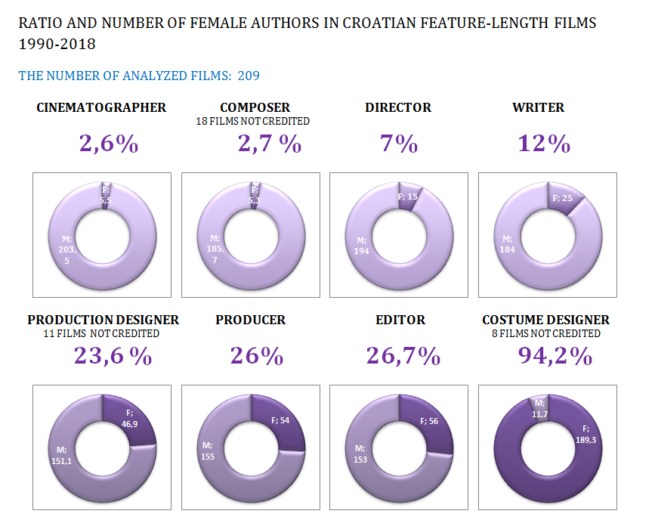
CROATIAN FILM PRODUCTION
1990 -2018

Slide 3
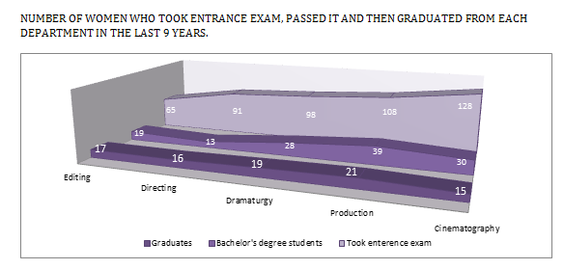
EDUCATION – THE ACADEMY OF DRAMATIC ART

Slide 4
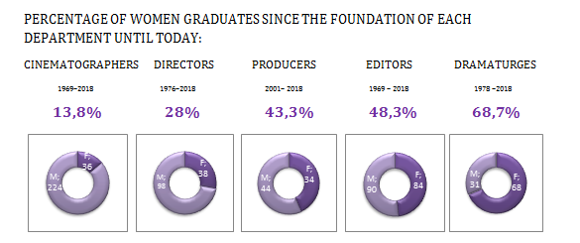
EDUCATION – THE ACADEMY OF DRAMATIC ART

Slide 5
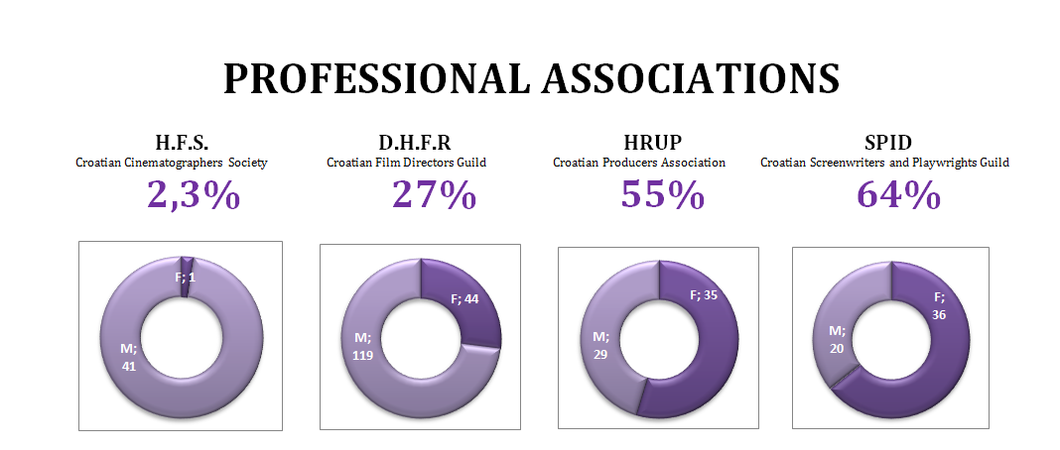
PROFESSIONAL ASSOCIATIONS

Slide 6
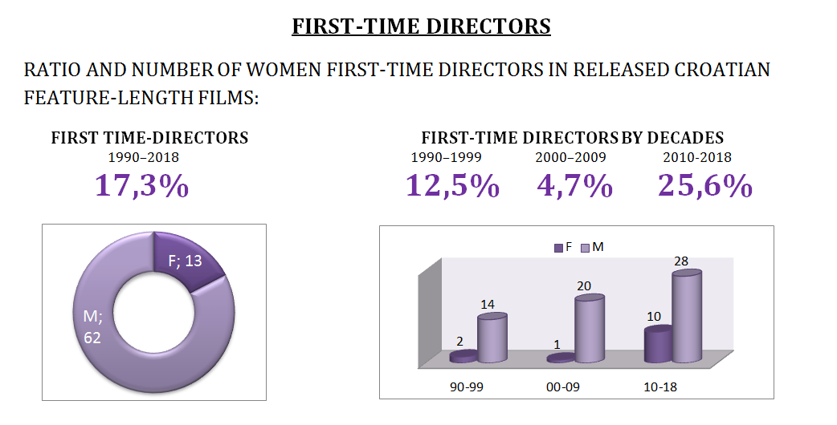
FIRST-TIME DIRECTORS

Slide 7
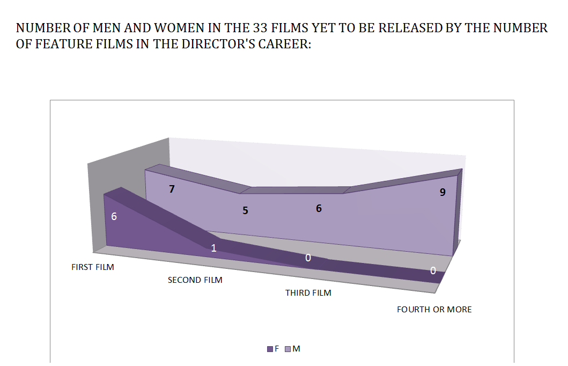
DIRECTOR’S CAREER

Slide 8
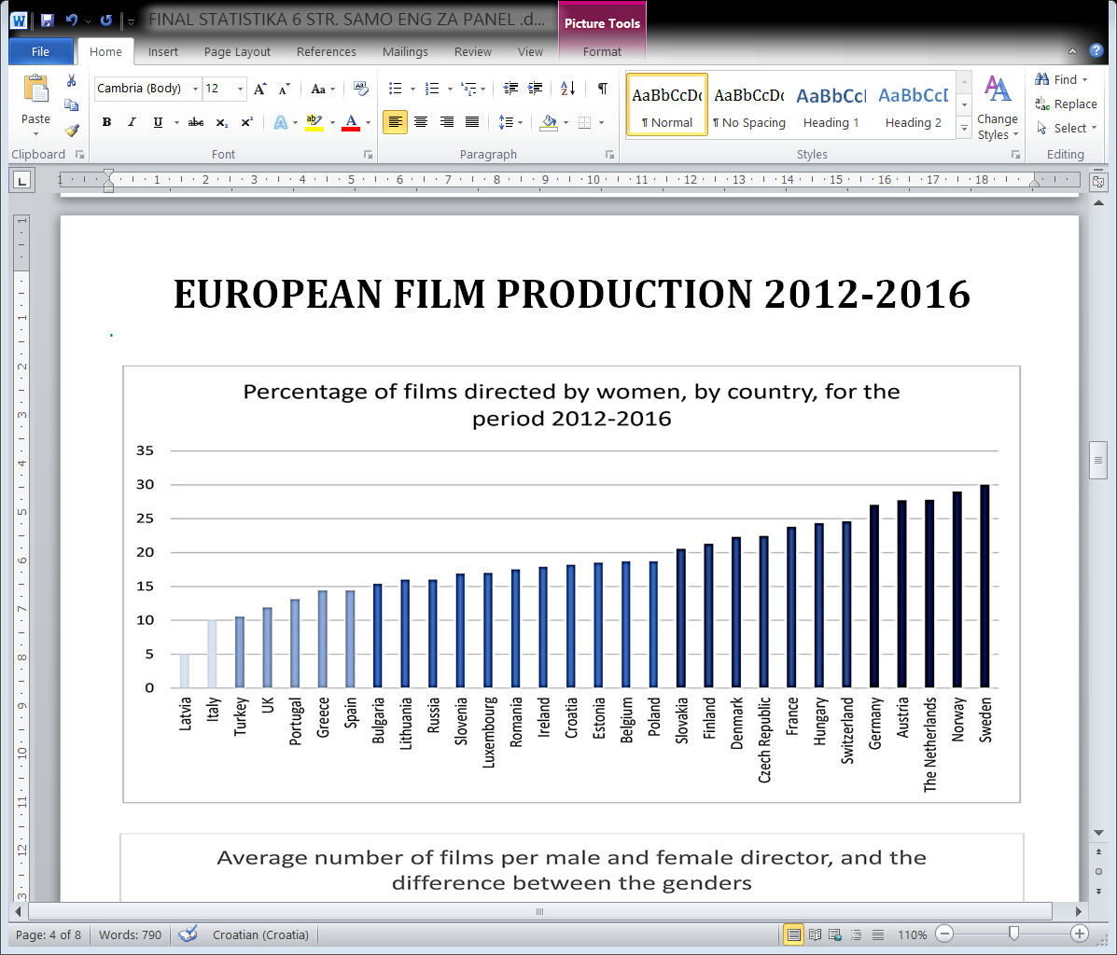
EUROPEAN FILM PRODUCTION
2012 - 2016

Slide 9
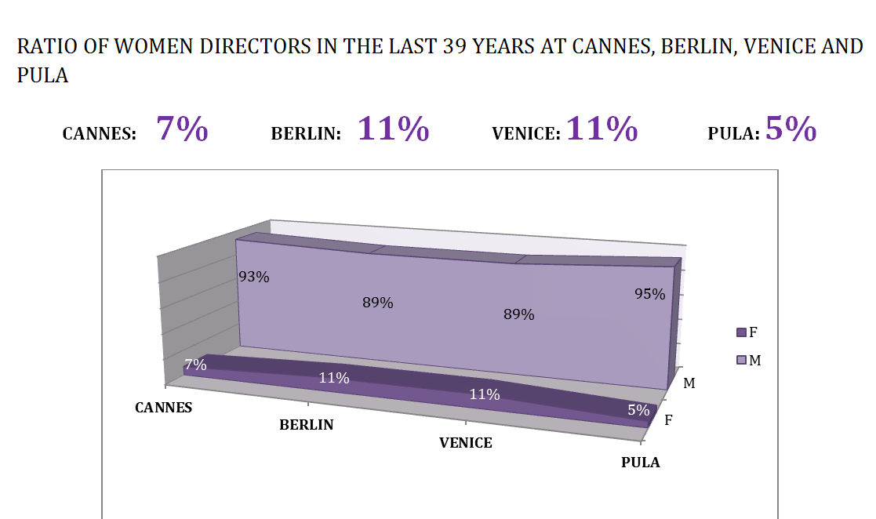
FILM FESTIVALS

Slide 10
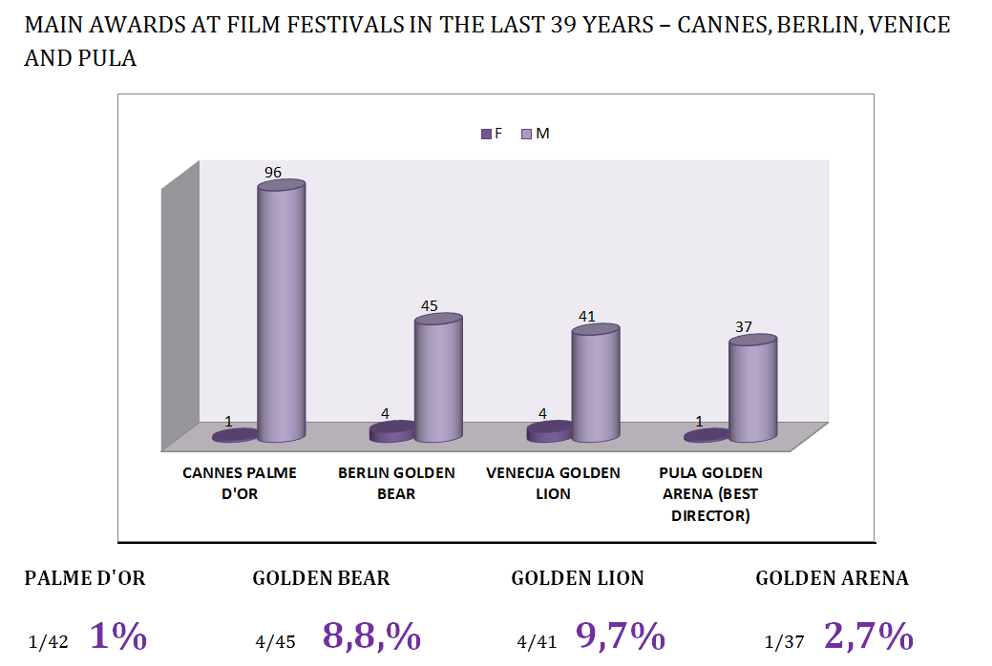
FILM FESTIVALS - AWARDS

Slide 11
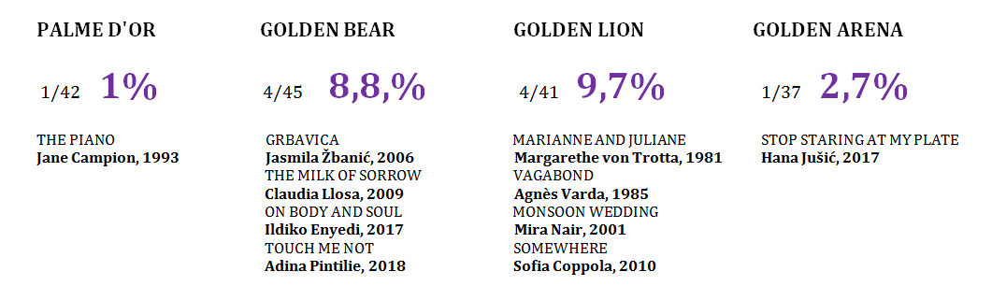
FILM FESTIVALS - AWARDS

